Slide 1
Computer Network
IP Addressing

Slide 2
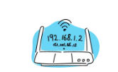
Internet Protocol (IP) Address
It is a numerical label assigned to each device connected to a computer network that uses the Internet protocol for communication
An IP address is a 32-bit address
The IP addresses are unique
Two portions
Network ID and Host ID

Slide 3
Address Space
The address space in a protocol that uses N-bits to define an address is: 2 ^{N}
an address space defines a range of discrete addresses, each of which may correspond to a network host
The address space of IPv4 is 2³² or 4,294,967,296
IPV4- Notations
Binary
Decimal

Slide 4
The address is made up of 32 binary bits, which can be divisible into a network portion and host portion. The 32 binary bits are broken into four octets (1 octet = 8 bits). Each octet is converted to decimal and separated by a dot. For this reason, an IP address is said to be expressed in dotted decimal format (for example, 172.16.81.100). The value in each octet ranges from 0 to 255 decimal, or 00000000 - 11111111 binary.
an IP Address gives us 2 pieces of valuable information:
1) It tells us which network the device is part of (Network ID).
2) It identifies that unique device within the network (Node ID).

Slide 5
Here is how binary octets convert to decimal: The right most bit, or least significant bit, of an octet holds a value of 2⁰. The bit just to the left of that holds a value of 2¹. This continues until the left-most bit, or most significant bit, which holds a value of 2⁷. So if all binary bits are a one, the decimal equivalent would be 255 as shown here:
1 1 1 1 1 1 1 1
128 64 32 16 8 4 2 1 (128+64+32+16+8+4+2+1=255)
Here is a sample octet conversion when not all of the bits are set to 1.
0 1 0 0 0 0 0 1
0 64 0 0 0 0 0 1 (0+64+0+0+0+0+0+1=65)
And this sample shows an IP address represented in both binary and decimal.
10. 1. 23. 19 (decimal)
00001010.00000001.00010111.00010011 (binary)

Slide 6
Exercise
Problem: Find the decimal equivalent of address
01110101 10010101 00011101 11101010
Solution:
Problem: Change the following IP address from dotted-decimal notation to binary notation: 111.56.45.78
Solution:

Slide 7

Find Errors
Ques: Find the error in the following IP Address 111.56.045.78
Sol: There are no leading zeroes in Dotted-decimal notation (045)
Ques: Find the error in the following IP Address 75.45.301.14
Sol: In decimal notation each number <= 255 and 301 is out of the range

Slide 8
A classful network is a network addressing architecture used in the Internet from 1981 until the introduction of Classless Inter-Domain Routing in 1993. The method divides the IP address space for Internet Protocol version 4 (IPv4) into five address classes based on the leading four address bits. Classes A, B, and C provide unicast addresses for networks of three different network sizes. Class D is for multicast networking and the class E address range is reserved for future or experimental purposes. Given an IP address, its class can be determined from the four high-order bits (the four left-most bits in the first octet).

Slide 9
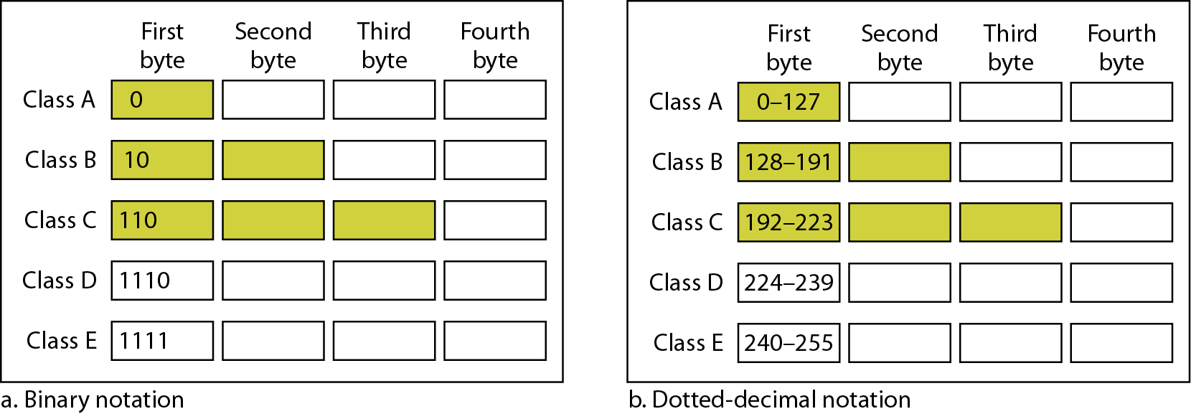
Classful Addressing
In classful addressing, the address space is divided into five classes: A, B, C, D, and E
Class D: multicast
Class E: reserved

Slide 10
In a Class A address, the first octet is the network portion, Octets 2, 3, and 4 (the next 24 bits) are for the local subnets and hosts. Class A addresses are used for networks that have up to 16777214 hosts!.
Explanation: Any Class A network has a total of 7 bits for the Network ID (bit 8 is always set to 0) and 24 bits for the Host ID. Now all we need to do is calculate how much 7 bits is:
2 to the power of 7 = 128 Networks and for the hosts : 2 to the power of 24 = 16,777,216 hosts in each Network, of which 2 cannot be used because one is the Network Address and the other is the Network Broadcast address . This is why when we calculate the "valid" hosts in a network we always subtract "2". So if I asked you how many "valid" hosts can you have a on Class A Network, you should answer 16,777,214 and NOT 16,777,216.
In a Class B address, the first two octets are the network portion, Octets 3 and 4 (16 bits) are for local subnets and hosts. Class B addresses are used for networks that have 65534 hosts.
Class B networks have 14 bits for the Network ID (Bits 15, 16 are set and can't be changed) and 16 bits for the Host ID, that means you can have up to '2 to the power of 14' = 16,384 Networks and '2 to the power of 16' = 65,536 Hosts in each Network, of which 2 cannot be used because one is the Network Address and the other is the Network Broadcast address .So if I asked you how many "valid" hosts can you have a on Class B Network, you should answer 65,534 and NOT 65,536.

Slide 11
In a Class C address, the first three octets are the network portion. Octet 4 (8 bits) is for local subnets and hosts - perfect for networks with less than 254 hosts.
Class C networks have 21 bits for the Network ID (Bits 22, 23, 24 are set and can't be changed) and 8 bits for the Host ID, that means you can have up to '2 to the power of 21' = 2,097,152 Networks and '2 to the power of 8' = 256 Hosts in each Network, of which 2 cannot be used because one is the Network Address and the other is the Network Broadcast address. So if I asked you how many "valid" hosts can you have a on Class C Network, you should answer 254 and NOT 256.

Slide 12
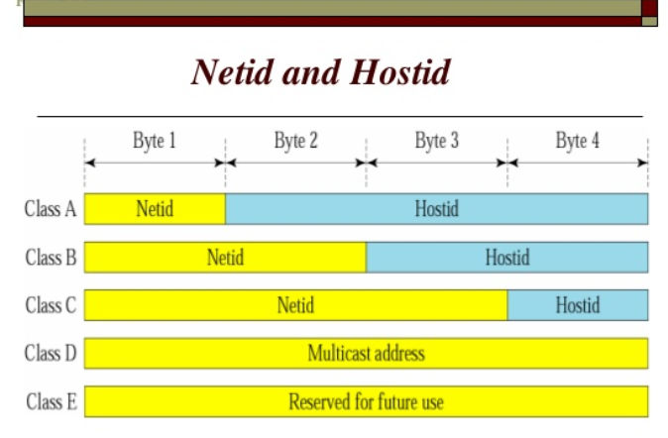
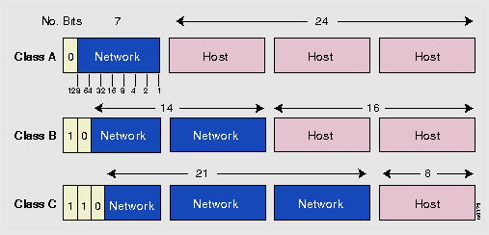

Slide 13

Exercise
Ques: Find the class of each address.
a. 00000001 00001011 00001011 11101111
b. 11000001 10000011 00011011 11111111
c. 14.23.120.8
d. 252.5.15.111
Sol:
a. The first bit is 0. This is a class A address.
b. The first 2 bits are 1; the third bit is 0. This is a class C address.
c. The first byte is 14; the class is A.
d. The first byte is 252; the class is E.

Slide 14
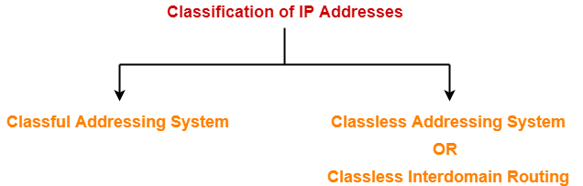

Slide 15
Classless Addressing
In classful addressing, a large part of the available addresses were wasted
millions of class A address are wasted, many of the class B address are wasted, whereas, number of addresses available in class C is so small that it cannot cater to the needs of organizations.
Classful addressing, which is almost obsolete, is replaced with classless addressing.
In IPv4 addressing, a block of addresses can be defined as
x.y.z.t /n
in which x.y.z.t defines one of the addresses and the /n defines the mask.
It is a 32-bit binary number that gives the network address in the address block when AND operation is bitwise applied on the mask and any IP address of the block.
The first address in the block can be found by setting the rightmost 32 − n bits to 0s.

Slide 16
What is Classless Addressing?
Classless addressing is a concept of addressing the IPv4 addresses. It was adopted after the failure of classful addressing. The classful addressing leads to wastage of addresses as it assigns a fixed-size block of addresses to the customer. But, the classless addressing assigns a block of addresses to the customer according to its requirement which prevents the wastage of addresses.
The classless IPv4 addressing does not divide the address space into classes like classful addressing. It provides a variable-length of blocks, which have a range of addresses according to the need of users.

Slide 17
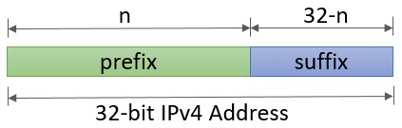
The classless addressing also divides the IPv4 address into two parts referred to as ‘
prefix‘ and ‘suffix‘. Prefix defines the network id whereas suffix defines the host address in the corresponding network.
The length of a prefix (n) can be 0, 1, 2, 3, . . . . ., 32. So, the value of suffix would automatically be (32- length of the prefix).
The length of the prefix (n) is added to the last of address separated by a slash. This is called slash notation and more formally
it is known as Classless Inter-Domain Routing (CIDR) notation.

Slide 18
Network address – It identifies a network on internet. Using this, we can find range of addresses in the network and total possible number of hosts in the network.
Mask – It is a 32-bit binary number that gives the network address in the address block when AND operation is bitwise applied on the mask and any IP address of the block.
The default mask in different classes are :
Class A – 255.0.0.0
Class B – 255.255.0.0
Class C – 255.255.255.0
Example : Given IP address 132.6.17.85 and default class B mask, find the beginning address (network address).
Solution : The default mask is 255.255.0.0, which means that the only the first 2 bytes are preserved and the other 2 bytes are set to 0. Therefore, the network address is 132.6.0.0.

Slide 19
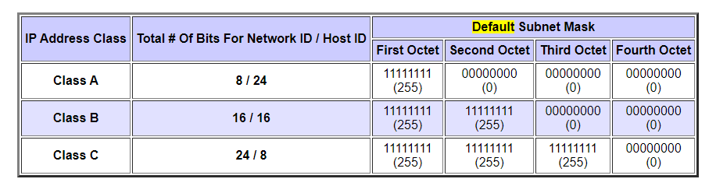
Structure of IPV4
Consist of NetID and HostID.
Default Subnet Mask of A,B and C class Network

Slide 20
Network , Host and Broadcast Addresses
Network Address is used by the outside world to route packets to the particular network.
Host address is the address of the machine.
Broadcast Address is the address used to broadcast message in the network
For Example
If IP Address is 192.168.10.0\24
First host address will be 192.168.10.1
Last host address will be 192.168.10.254
Broadcast address will be 192.168.10.255
the first (all 0s) represents the network address
while the last (all 1s) represents the broadcast address.
Number of available host in the network can be found out
2 ^{(number of host bits)}-2

Slide 21
CIDR Block
For the correct working of CIDR blocks, three restrictions are implemented on the blocks of classless addressing.
A block of addresses allocated to an organization must have the contiguous unallocated addresses.
The number of addresses in a block allocated to an organization must be the power of 2.
The first address of every block must be divisible by the length of the block.

Slide 22
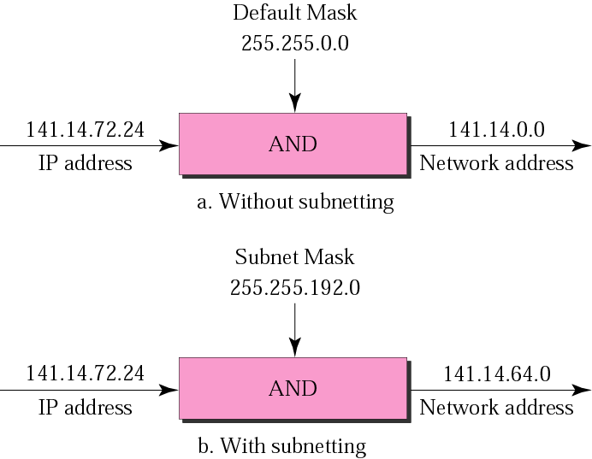
Network Address Calculation

Slide 23
First And Last Address of the Block
Ques: One of the address is 205.16.37.39/28. what is first and last address of the block?
Sol: Since mask is 28 then setting 32-n bits i.e 32-28 = 4 bits to 0.
Converting 39 into binary form 00100111.
Using last four bits only ie. 0111 and setting them to 0000. It comes out to be 00100000.
The decimal equivalent is 32.
First address is 205.16.37.32
Last address can be found by setting last four bits to one. 00101111 i.e. 205.16.37.47
Number of addresses - 2 ³²⁻²⁸ or 16.
First address of the block can be found by setting rightmost (32-n) bits to zeros.
Last address of the block can be found be setting rightmost (32-n) bits to ones.

Slide 24
The first address in a block is normally not assigned to any device
First Address is used as the network address that represents the organization to the rest of the world.
The Last address is used as a broadcast Address of the network
Each address in the block can be considered as a two-level hierarchical structure: the leftmost n bits (prefix) define the network;
the rightmost 32 − n bits define the host.

Slide 25
Exercise
Problem: An ISP is granted a block of addresses starting with 190.100.0.0/16 (65,536 addresses). The ISP needs to distribute these addresses to three groups of customers as follows:
a. The first group has 64 customers; each needs 256 addresses.
b. The second group has 128 customers; each needs 128 addresses.
c. The third group has 128 customers; each needs 64 addresses.
Assume the blocks of IPs are sequentially assigned. Design the sub blocks and find out how many addresses are still available after these allocations.

Slide 26
Group 1
For this group, each customer needs 256 addresses. This means that 8 (log2 256) bits are needed to define each host. The prefix length is then 32 − 8 = 24. The addresses are

Slide 27
Group 2
For this group, each customer needs 128 addresses. This means that 7 (log2 128) bits are needed to define each host. The prefix length is then 32 − 7 = 25. The addresses are

Slide 28
Group 3
For this group, each customer needs 64 addresses. This means that 6 (log₂64) bits are needed to each host. The prefix length is then 32 − 6 = 26. The addresses are
Number of granted addresses to the ISP: 65,536
Number of allocated addresses by the ISP: 40,960
Number of available addresses: 24,576

Slide 29
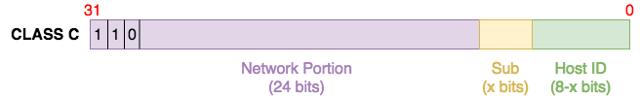
Subnetting
What is Subnetting?
That issue of IP address wastage brings us to the topic at hand – Subnetting. Subnetting allows you to create smaller network (sub networks; subnets) inside a large network by borrowing bits from the Host ID portion of the address. We can use those borrowed bits to create additional networks, resulting in smaller-sized networks.
Subnetting: Dividing a large block of addresses into several contiguous sub-blocks and assigning these sub-blocks to different smaller networks is called subnetting. It is a practice that is widely used when classless addressing is done

Slide 30
Subnet Masks
With what we have done, we have created a problem for computers and other networking devices: how are they supposed to differentiate between a subnet 192.168.1.32 and an IP address 192.168.1.32? This is where subnet masks (also called network masks) come in. A subnet mask is the representation of the network portion of an address. It is also made up of 32 bits with all the bits that represent the network portion being marked as 1s and the other parts marked as 0s.
For example, the subnet masks of the IP address classes are:
Class A: 255.0.0.0
Class B: 255.255.0.0
Class C: 255.255.255.0

Slide 31
Why do we need subnetting?
Now that we have seen what subnetting is, let us consider some of the reasons we create subnets:
Reduce wastage: As we have already seen, subnetting (and CIDR on a larger scale) helps us conserve IP addresses. While this is very important on the Internet (conserving public IP addresses), it is also useful on local area networks (LANs) where private IP addresses are used.
Improve Network Performance: Subnetting improves the overall performance of a network. The larger a network is, the busier (more congested) it is. Consider the example of broadcasts – every host within an individual network will receive a broadcast even when it is not meant for them. This can affect performance especially during issues like broadcast storms. Therefore, the smaller the network, the more you can contain such issues within the subnet.
Isolation: With smaller networks, you are able to isolate effectively as faults inside one subnet will not necessarily spread into other subnets. This is also important during security incidents so that even if one subnet is affected, the entire network is not brought down.
Easier administration: Subnetting, when done properly, can make network administration more effective. For example, a multinational organization can design their network in such a way that each region is assigned an IP address block from a larger address block and subnetting is used within regions to further divide the blocks among networks. This kind of design also improves routing as the routers in one region only need to know the “summarized” IP address block for other regions rather than all the smaller IP address blocks. This reduces the size of the routing table and ensures that fluctuations in one region do not affect the entire network

Slide 32
Subnetting
Subnetting is done by borrowing bits from the host part and add them the network part
Default mask and Subnet Mask
Finding Subnet Address
Given an IP address, we can find the subnet address the same way we found the network address. We apply the mask to the address.

Slide 33
Subnet Address- 1st Approach
Straight Method
Example: What is the subnetwork address if the destination address is 200.45.34.56 and the subnet mask is 255.255.240.0?
Sol
In the straight method, we use binary notation for both the address and the mask and then apply the AND operation to find the subnet address
11001000 00101101 00100010 00111000
11111111 11111111 11110000 00000000
11001000 00101101 00100000 00000000
The subnetwork address is 200.45.32.0.

Slide 34
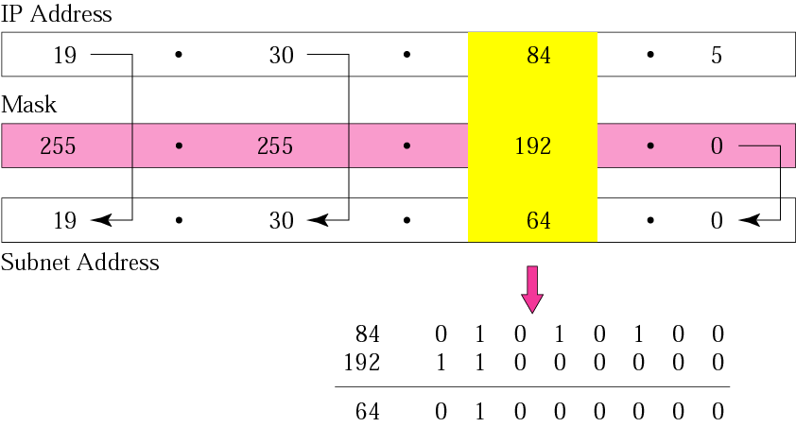
Subnet Address- 2nd Approach
Short – Cut Method
Example: What is the subnetwork address if the destination address is 19.30.80.5 and the mask is 255.255.192.0?
Sol
If the byte in the mask is 255, copy the byte in the address. If the byte in the mask is 0, replace the byte in the address with 0. If the byte in the mask is neither 255 nor 0, we write the mask and the address in binary and apply the AND operation.

Slide 35
Exercise
Problem: A company is granted the site address 201.70.64.0 (class C). The company needs six subnets. Design the subnets.
Sol
The number of 1s in the default mask is 24 (class C).
The company needs six subnets. This number 6 is not a power of 2. The next number that is a power of 2 is 8 (2³). We need 3 more 1s in the subnet mask. The total number of 1s in the subnet mask is 27 (24 + 3).The total number of 0s is 5 (32 − 27). The number of subnets is 8. The number of addresses in each subnet is 2⁵ (5 is the number of 0s) or 32
The number of subnets must be a power of 2.

Slide 36
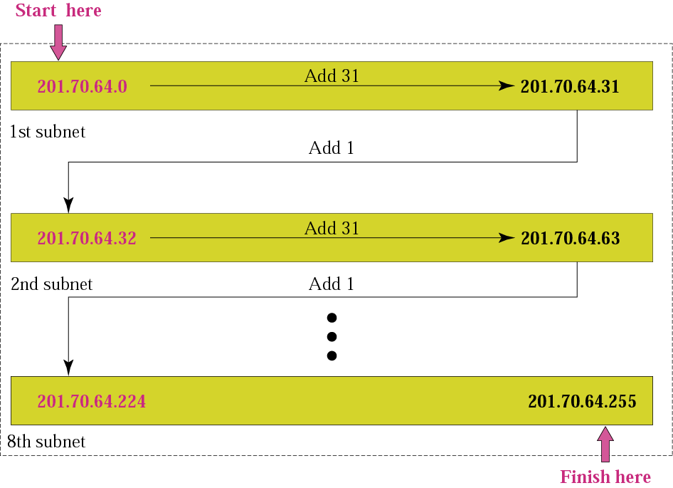

Slide 37
Class Practice Quesion
Problem: A company is granted the site address 181.56.0.0 (class B). The company needs 1000 subnets. Design the subnets.
Sol: The number of 1s in the default mask is 16 (class B). The company needs 1000 subnets. This number is not a power of 2. The next number that is a power of 2 is 1024 (2¹⁰). We need 10 more 1s in the subnet mask. The total number of 1s in the subnet mask is 26 (16 + 10). The total number of 0s is 6 (32 − 26).
The mask is 11111111 11111111 11111111 11000000 or 255.255.255.192.
The number of subnets is 1024.
The number of addresses in each subnet is 2⁶ (6 is the number of 0s) or 64.

Slide 38
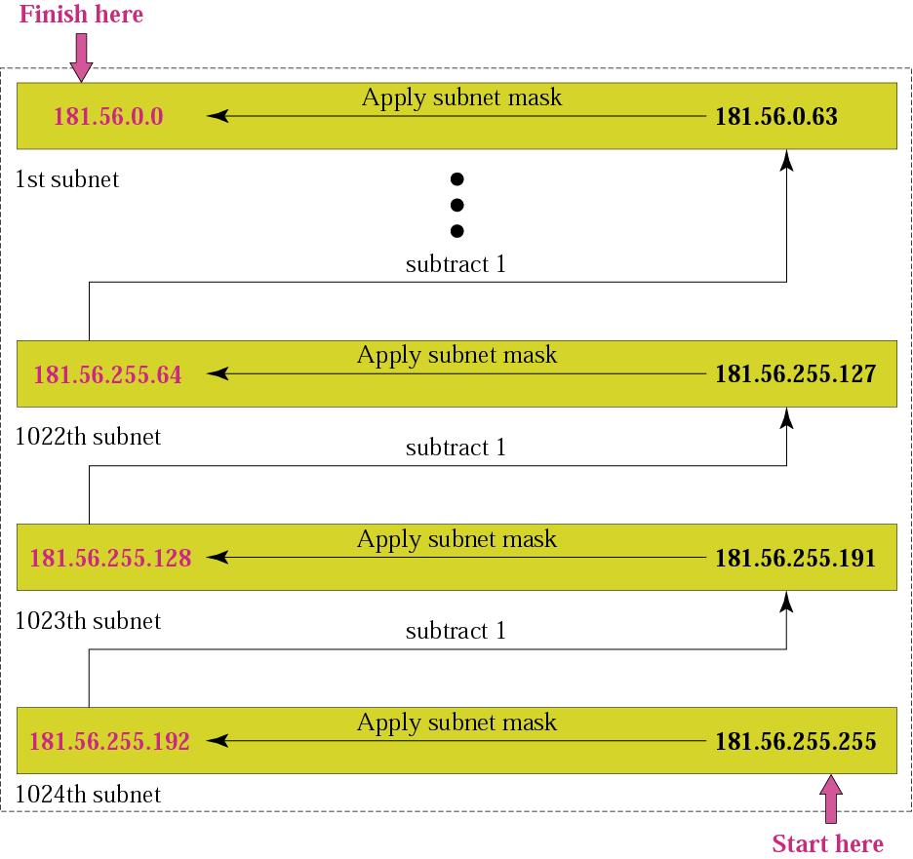

Slide 39
Supernetting
Supernetting is the opposite of subnetting
In subnetting you borrow bits from the host part
Supernetting is done by borrowing bits from the network side.
And combine a group of networks into one large supernetwork.

Slide 40
Supernetting
Rules
The number of blocks must be a power of 2 (1, 2, 4, 8, 16, . . .).
The blocks must be contiguous in the address space (no gaps between the blocks).
The third byte of the first address in the superblock must be evenly divisible by the number of blocks. In other words, if the number of blocks is N, the third byte must be divisible by N.

Slide 41
Exercise
Problem :A company needs 600 addresses. Which of the following set of class C blocks can be used to form a supernet for this company?
a. 198.47.32.0 198.47.33.0 198.47.34.0
b. 198.47.32.0 198.47.42.0 198.47.52.0 198.47.62.0
c. 198.47.31.0 198.47.32.0 198.47.33.0 198.47.52.0
d. 198.47.32.0 198.47.33.0 198.47.34.0 198.47.35.0
Sol:
a. No, there are only three blocks.
b. No, the blocks are not contiguous.
c. No, not contigous
d. Yes, all three requirements are fulfilled.

Slide 42
Exercise
Problem: We need to make a supernetwork out of 16 class C blocks. What is the supernet mask?
Sol: We need 16 blocks. For 16 blocks we need to change four 1s to 0s in the default mask. So the mask is
11111111 11111111 11110000 00000000
or
255.255.240.0

Slide 43
Class Practice Question
Problem: A supernet has a first address of 205.16.32.0 and a supernet mask of 255.255.248.0. A router receives three packets with the following destination addresses:
205.16.37.44
205.16.42.56
205.17.33.76 Which packet belongs to the supernet?
Sol: We apply the supernet mask to see if we can find the beginning address.
205.16.37.44 AND 255.255.248.0 ➔ 205.16.32.0
205.16.42.56 AND 255.255.248.0 ➔ 205.16.40.0
205.17.33.76 AND 255.255.248.0 ➔ 205.17.32.0
Only the first address belongs to this supernet.

Slide 44
Classless Addresing
The beginning address must be evenly divisible by the number of addresses. For example, if a block contains 4 addresses, the beginning address must be divisible by 4. If the block has less than 256 addresses, we need to check only the rightmost byte. If it has less than 65,536 addresses, we need to check only the two rightmost bytes, and so on.
Example: Which of the following can be the beginning address of a block that contains 1024 addresses?
205.16.37.32 190.16.42.0 17.17.32.0 123.45.24.52
Sol: To be divisible by 1024, the rightmost byte of an address should be 0 and the second rightmost byte must be divisible by 4. Only the address 17.17.32.0 meets this condition.

Slide 45
Exercise
A small organization is given a block with the beginning address and the prefix length 205.16.37.24/29 (in slash notation). What is the range of the block?
Sol: The beginning address is 205.16.37.24. To find the last address we keep the first 29 bits and change the last 3 bits to 1s.
Beginning: 11001111 00010000 00100101 00011000
Ending : 11001111 00010000 00100101 00011111
There are only 8 addresses in this block.

Slide 46
Finding the Network Address 
We can derive the network address if we know 
One of the address in the block 
The prefix length, or a mask, or the suffix length
 Solution 1  AND the mask and the address to find the first address, i.e., network address
 Solution 2  Just keep the first n bits and change the rest to 0s

Slide 47
Exercise
What is the network address if one of the addresses is 167.199.170.82/27?
Sol: The prefix length is 27, which means that we must keep the first 27 bits as is and change the remaining bits (5) to 0s. The 5 bits affect only the last byte. The last byte is 01010010. Changing the last 5 bits to 0s, we get 01000000 or 64. The network address is 167.199.170.64/27.

Slide 48
Practice Question
An organization is granted the block 130.34.12.64/26. The organization needs to have four subnets. What are the subnet addresses and the range of addresses for each subnet?
Sol: The suffix length is 6. This means the total number of addresses in the block is 64 (2⁶). If we create four subnets, each subnet will have 16 addresses.
Let us first find the subnet prefix (subnet mask). We need four subnets, which means we need to add two more 1s to the site prefix. The subnet prefix is then /28.
Subnet 1: 130.34.12.64/28 to 130.34.12.79/28.
Subnet 2 : 130.34.12.80/28 to 130.34.12.95/28.
Subnet 3: 130.34.12.96/28 to 130.34.12.111/28.
Subnet 4: 130.34.12.112/28 to 130.34.12.127/28.

Slide 50
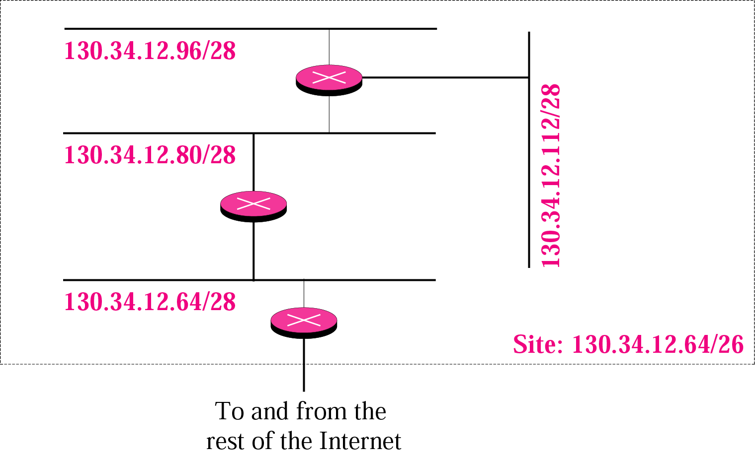

Slide 51
Self Practice Questions
Ques1: A supernet has a first address of 205.16.32.0 and a supernet mask of 255.255.248.0. How many blocks are in this supernet and what is the range of addresses?
Ques 2: An ISP is granted a block of addresses starting with 190.100.0.0/16. The ISP needs to distribute these addresses to three groups of customers as follows:
1. The first group has 64 customers; each needs 256 addresses.
2. The second group has 128 customers; each needs 128 addresses.
3. The third group has 128 customers; each needs 64 addresses. Design the subblocks and give the slash notation for each subblock. Find out how many addresses are still available after these allocations.

Slide 52
Self Practice Question Solutions
Sol1: The supernet has 21 1s. The default mask has 24 1s. Since the difference is 3, there are 2³ or 8 blocks in this supernet. The blocks are 205.16.32.0 to 205.16.39.0. The first address is 205.16.32.0. The last address is 205.16.39.255.
Sol2: Group 1
For this group, each customer needs 256 addresses. This means the suffix length is 8 (2⁸ = 256). The prefix length is then 32 - 8 = 24.
01: 190.100.0.0/24 ➔190.100.0.255/24
02: 190.100.1.0/24 ➔190.100.1.255/24
…………………………………..
64: 190.100.63.0/24➔190.100.63.255/24
Total = 64 × 256 = 16,384

Slide 53
Self Practice Question Solutions
Group 2
For this group, each customer needs 128 addresses. This means the suffix length is 7 (2⁷ = 128). The prefix length is then 32 - 7 = 25. The addresses are:
001: 190.100.64.0/25 ➔190.100.64.127/25
002: 190.100.64.128/25 ➔190.100.64.255/25
………………..
128: 190.100.127.128/25 ➔190.100.127.255/25
Total = 128 × 128 = 16,384
Group 3
For this group, each customer needs 64 addresses. This means the suffix length is 6 (2⁶ = 64). The prefix length is then 32 - 6 = 26.
001:190.100.128.0/26 ➔190.100.128.63/26
002:190.100.128.64/26 ➔190.100.128.127/26
…………………………
128:190.100.159.192/26 ➔190.100.159.255/26
Total = 128 × 64 = 8,192

Slide 54
Self Practice Question Solutions
Number of granted addresses: 65,536
Number of allocated addresses: 40,960
Number of available addresses: 24,576

Slide 55

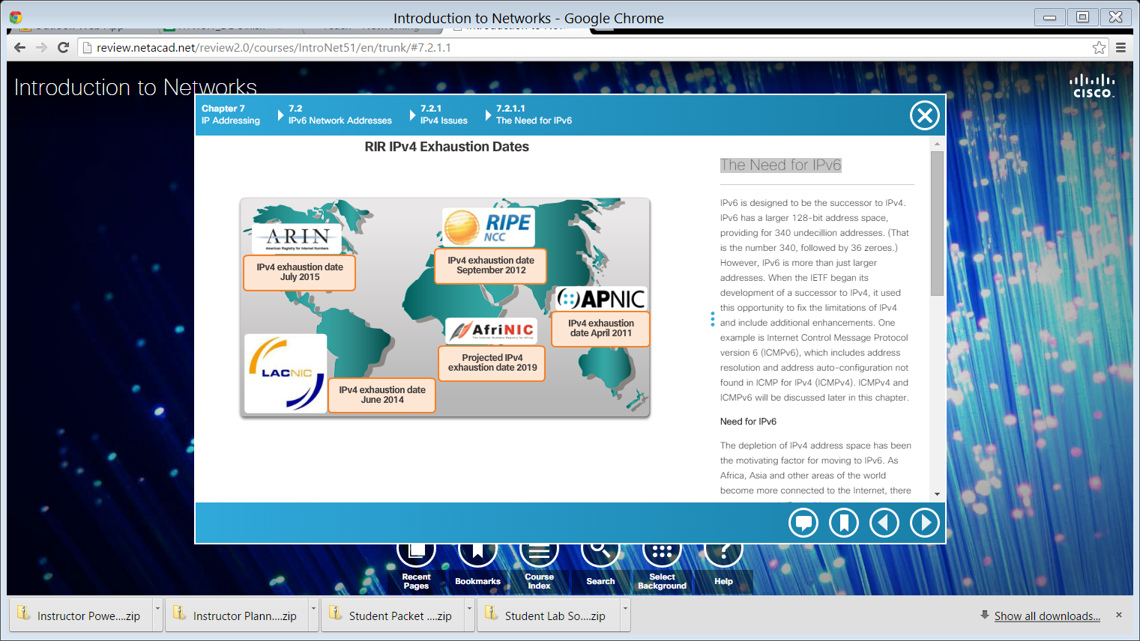
The Need for IPv6
The depletion of IPv4 address space has been the motivating factor for moving to IPv6.
Notes:
7.2.1.1 The Need for IPv6

Slide 56
IPv4 and IPv6 Coexistence
The migration techniques can be divided into three categories: Dual STack, Tunneling, and Translation.
Dual stack devices run both IPv4 and IPv6 protocol stacks simultaneously. Devices run both IPv4 and IPv6 protocol stacks simultaneously.
Tunneling is a method of transporting an IPv6 packet over an IPv4 network. The IPv6 packet is encapsulated inside an IPv4 packet, similar to other types of data.
Network Address Translation 64 (NAT64) allows IPv6-enabled devices to communicate with IPv4-enabled devices using a translation technique similar to NAT for IPv4. An IPv6 packet is translated to an IPv4 packet and vice versa.
Notes:
7.2.1.2 IPv4 and IPv6 Coexistence

Slide 57
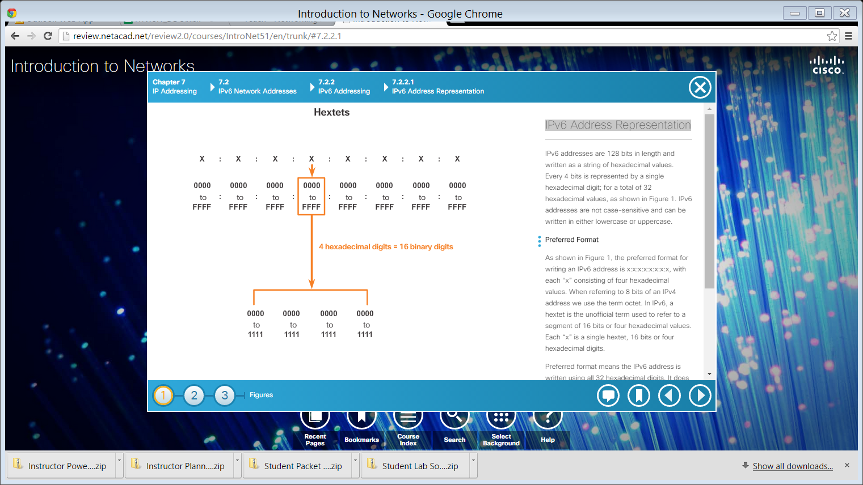
IPv6 Address Representation
Hextets – 4 Hexadecimal digits = 16 binary digits
Notes:
7.2.2.1 IPv6 Address Representation

Slide 58
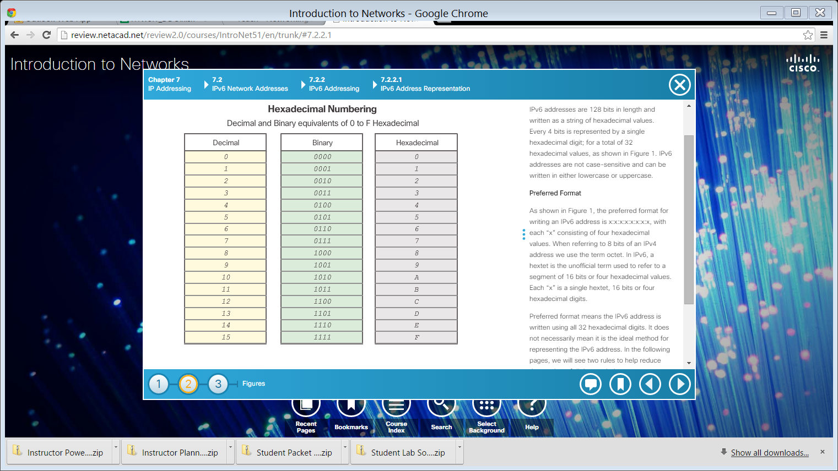
IPv6 Address Representation (cont.)
Notes:
7.2.2.1 IPv6 Address Representation (Cont.)

Slide 59
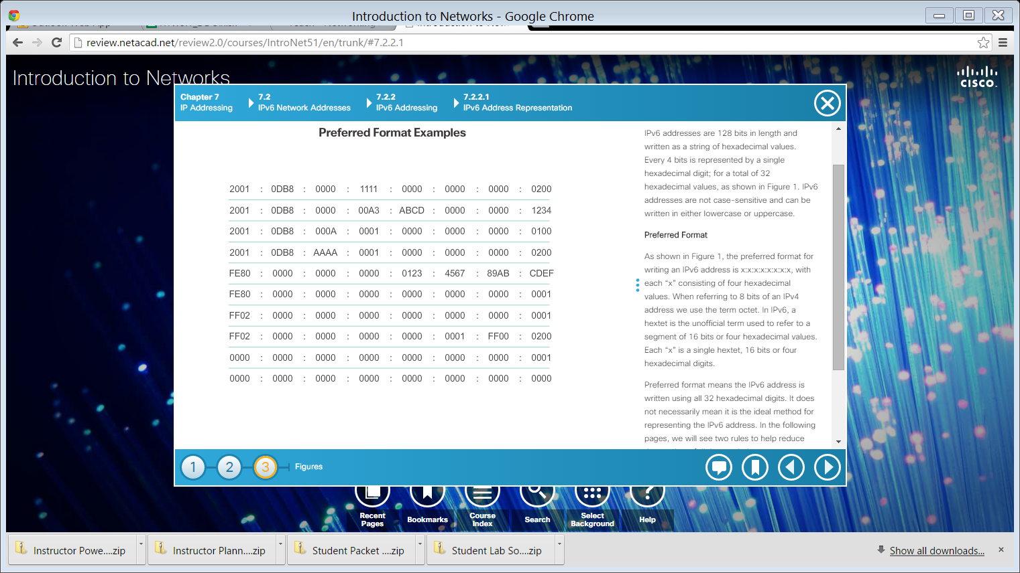
IPv6 Address Representation (cont.)
Notes:
7.2.2.1 IPv6 Address Representation (Cont.)

Slide 60
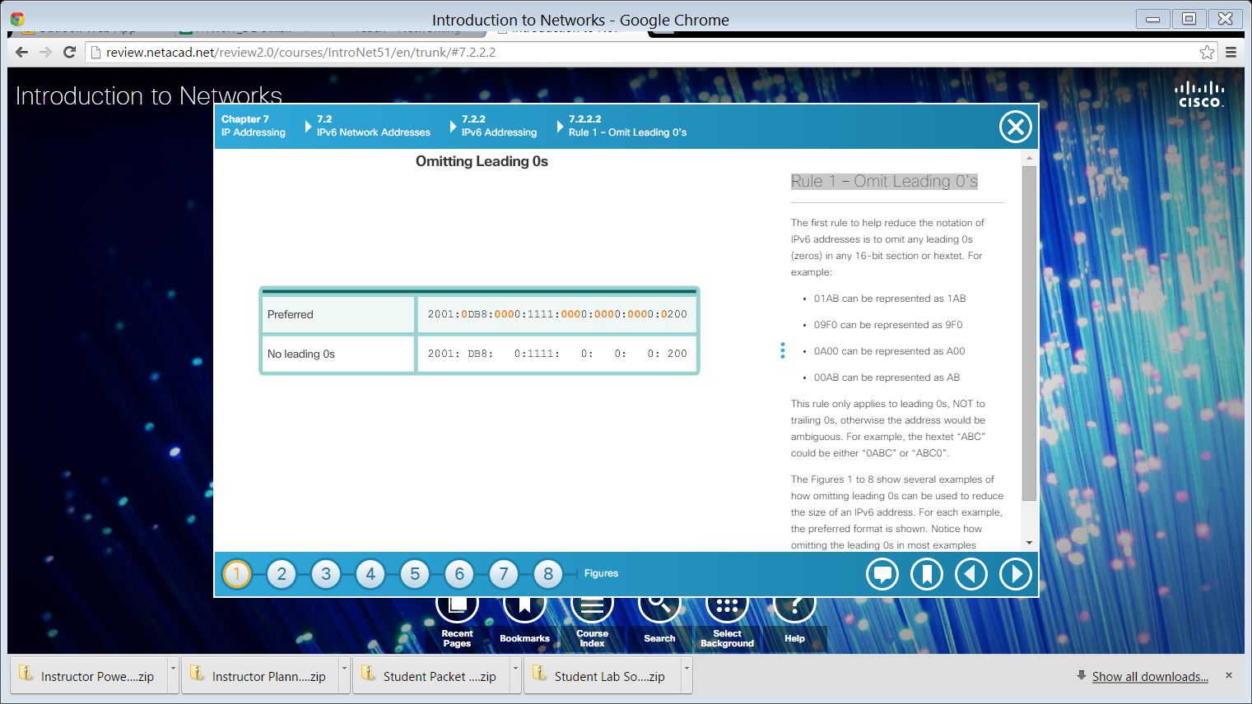


Rule 1 – Omit Leading 0’s
Example 1
Example 2
Example 3
Notes:
7.2.2.2 Rule 1 – Omit Leading 0’s

Slide 61

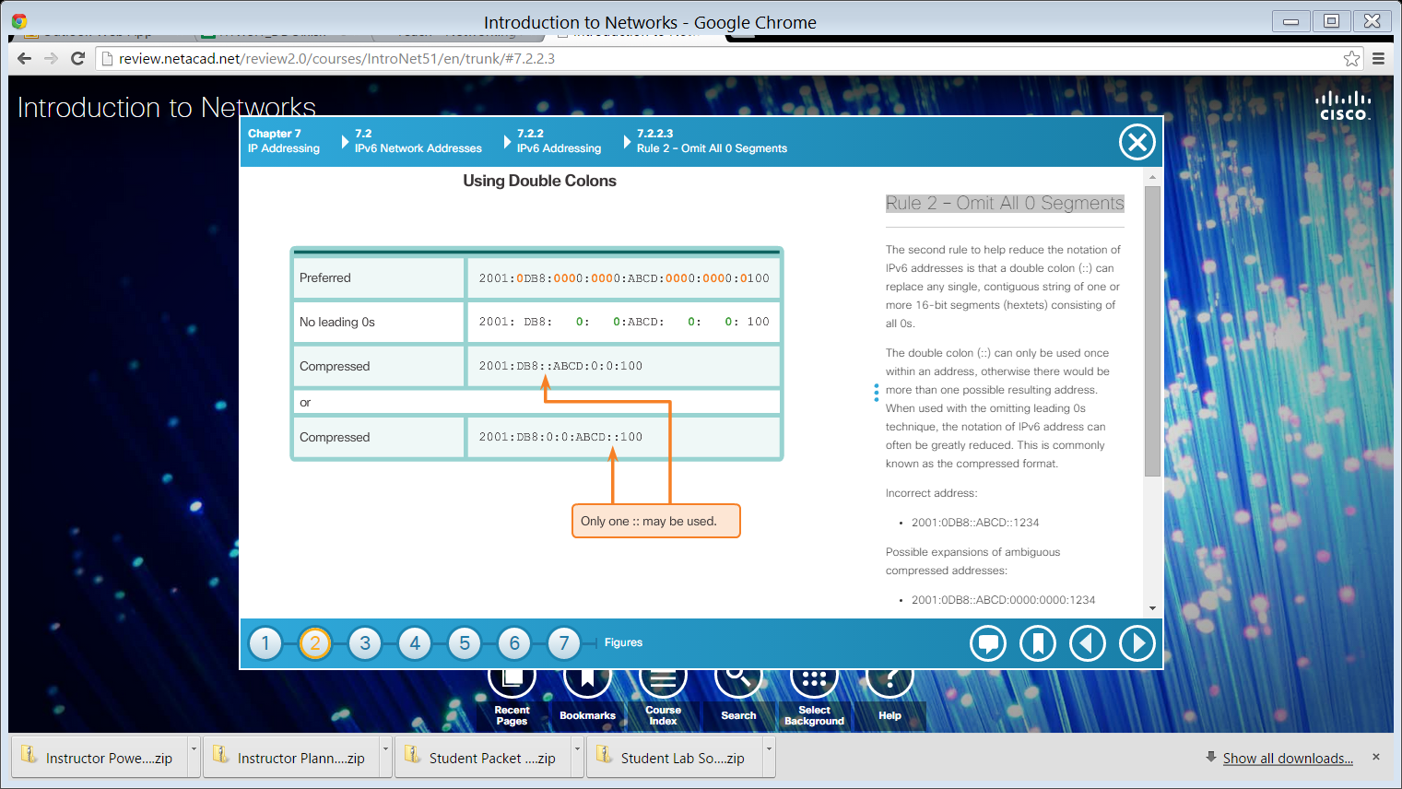
Rule 2 – Omit All 0 Segments
Example 1
Example 2
Notes:
7.2.2.3 Rule 2 – Omit All 0 Segments

Slide 62


Rule 2 – Omit All 0 Segments (cont.)
Example 3
Example 4
Notes:
7.2.2.3 Rule 2 – Omit All 0 Segments (Cont.)
7.2.2.4 Activity – Practicing IPv6 Address Representations

Slide 63
IPv6 Address Types
There are two types of IPv6 addresses:
Unicast
Multicast
Note: IPv6 does not have broadcast addresses.
Notes:
7.2.3.1 IPv6 Address Types

Slide 64
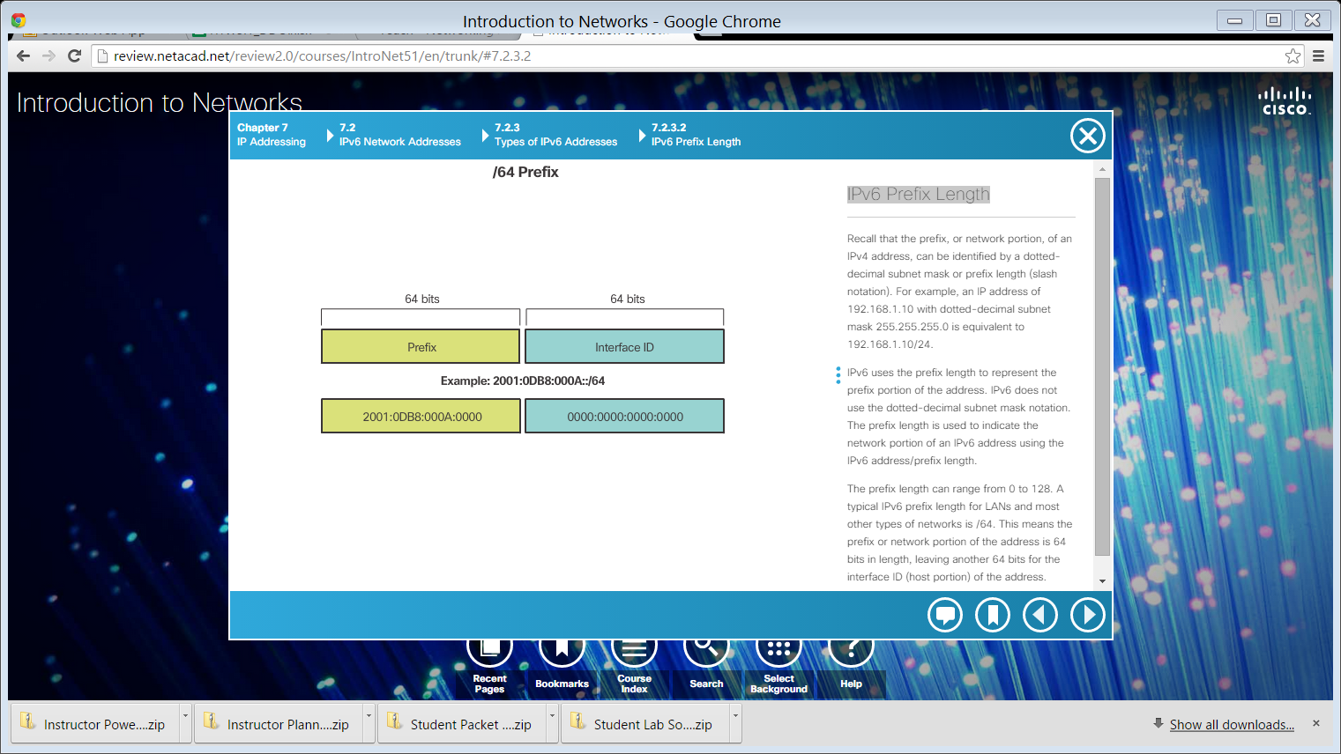
IPv6 Prefix Length
IPv6 does not use the dotted-decimal subnet mask notation.
Prefix length indicates the network portion of an IPv6 address using the following format:
IPv6 address /prefix length
Prefix length can range from 0 to 128
Typical prefix length is /64
Notes:
7.2.3.2 IPv6 Prefix Length

Slide 65
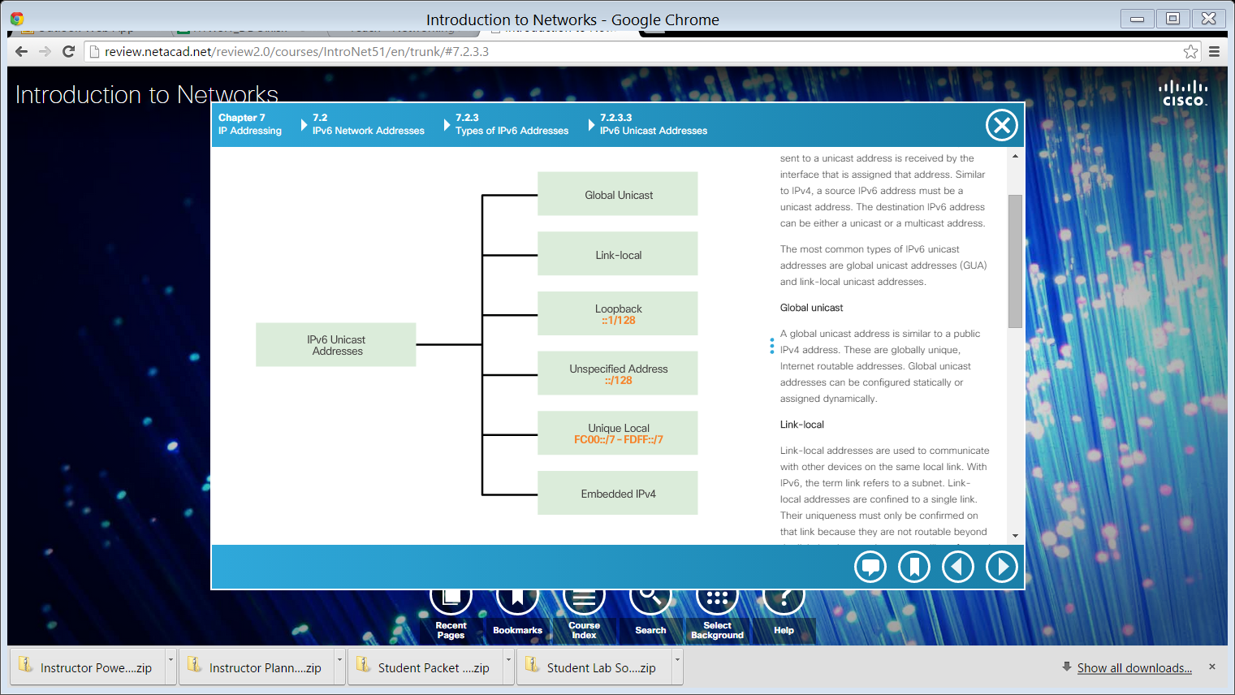
IPv6 Unicast Addresses
Notes:
7.2.3.3 IPv6 Unicast Addresses

Slide 66
A global unicast address is similar to a public IPv4 address. These are globally unique, Internet routable addresses. Global unicast addresses can be configured statically or assigned dynamically.
Link-local addresses are used to communicate with other devices on the same local link. With IPv6, the term link refers to a subnet. Link-local addresses are confined to a single link. Their uniqueness must only be confirmed on that link because they are not routable beyond the link. In other words, routers will not forward packets with a link-local source or destination address.
Unique local addresses are used for local addressing within a site or between a limited number of sites. These addresses should not be routable in the global IPv6 and should not be translated to a global IPv6 address. Unique local addresses are in the range of FC00::/7 to FDFF::/7.

Slide 67
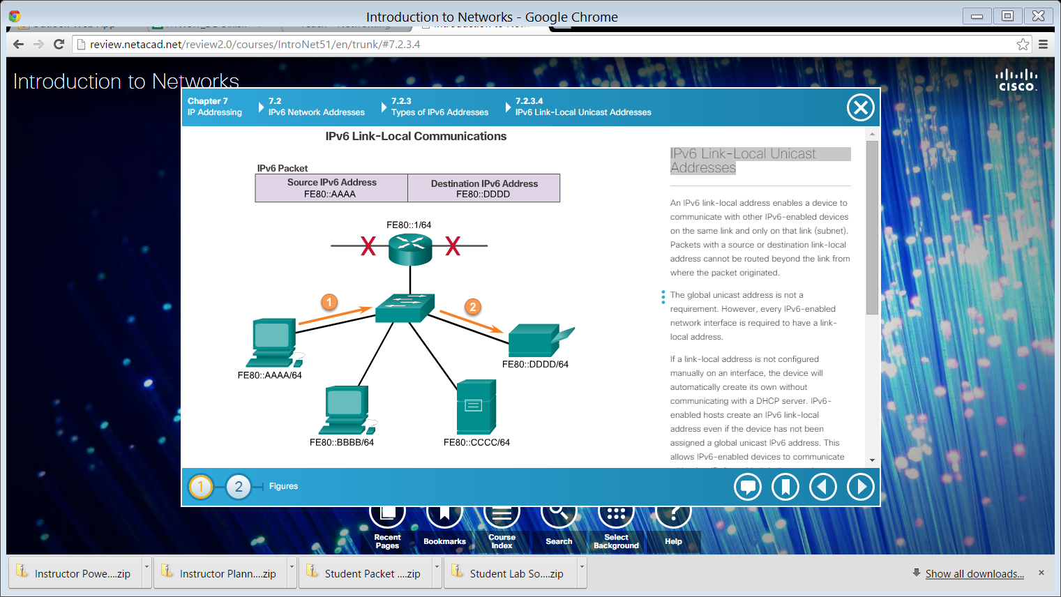
IPv6 Link-Local Unicast Addresses
Notes:
7.2.3.4 IPv6 Link-Local Unicast Addresses

Slide 68
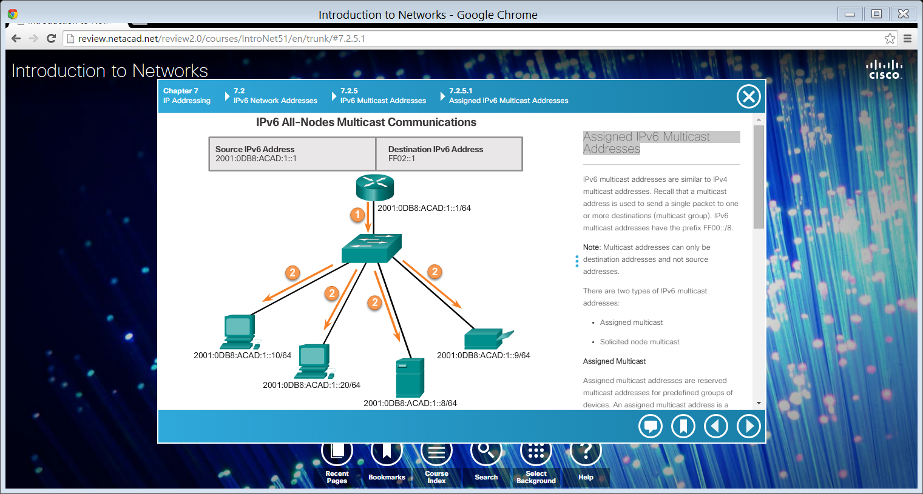
Assigned IPv6 Multicast Addresses
IPv6 multicast addresses have the prefix FF00::/8.
There are two types of IPv6 multicast addresses:
Assigned multicast
Solicited node multicast
Notes:
7.2.5.1 Assigned IPv6 Multicast Addresses

Slide 69
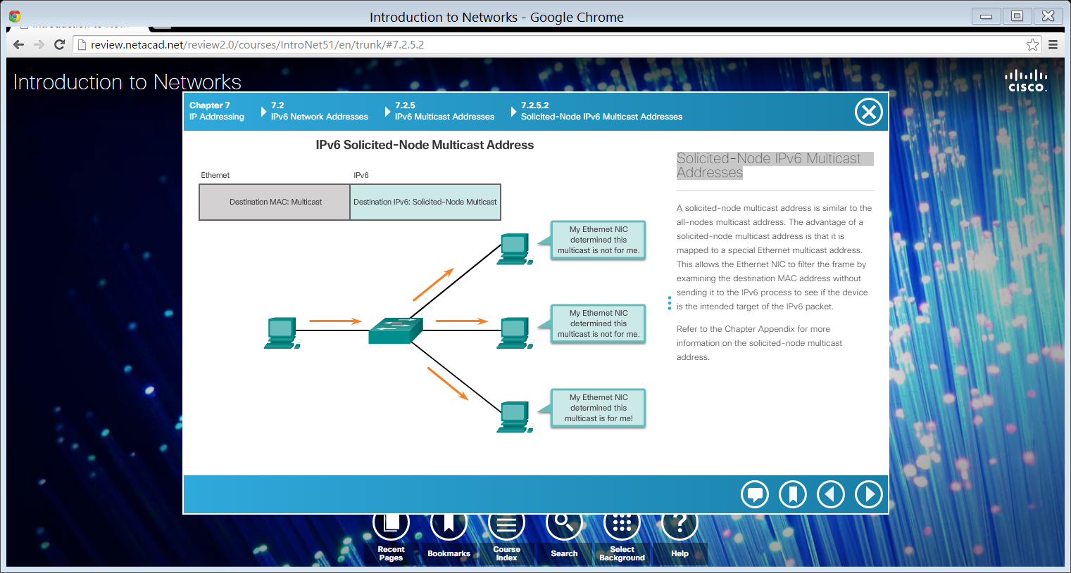
Solicited-Node IPv6 Multicast Addresses
Notes:
7.2.5.2 Solicited-Node IPv6 Multicast Addresses
7.2.5.3 Lab – Identifying IPv6 Addresses
7.2.5.4 Lab – Configuring IPv6 Addresses on Network Devices

Slide 70


